Slide 1
Forecasting the Computerisability of Tasks
$${Kieran Marray}^{1, 2},{Shruthi Prabhakar}^{3}, {Rob Axtell}^{3,4}$$
1. Institute for New Economic Thinking at the Oxford Martin School, University of Oxford
2. Oxford Mathematical Institute, University of Oxford
3. Department of Computational Social Science, George Mason University
4. Santa Fe Institute

Slide 2
Outline
Current approaches
Our model
Results
Special thanks for help and comments from: Tom Pike, Sean Luke, François Lafond, Jens Madsen, and Maria Del Rio Chanona amongst many others.
Marray is grateful for funding from the Laidlaw Research Scholarship at the University of Oxford.

Slide 3
Current Approaches

Slide 4
Current Approaches
Notable previous predictions: Frey and Osborne (2013, 2017), Manyika et al. (2017), Blinder et al. (2018)
Get experts or non-experts to label tasks/occupations as computerisable or not by t, then use labels to forecast

Slide 5
Example – Frey and Osborne (2017)
Get set of experts to ‘eyeball’ descriptions of 70 O*NET occupations – experts label occupations as computerisable\not by 2050
Expert opinions train gaussian process classifier - feature vectors are scores on 9 O*NET abilities measures that are ‘bottlenecks to automation’ (Frey and Osborne 2013, 2017)
Apply the classifier to all other O*NET occupations to produce forecasts –find 47% of O*NET occupations are computerisable by 2050

Slide 6
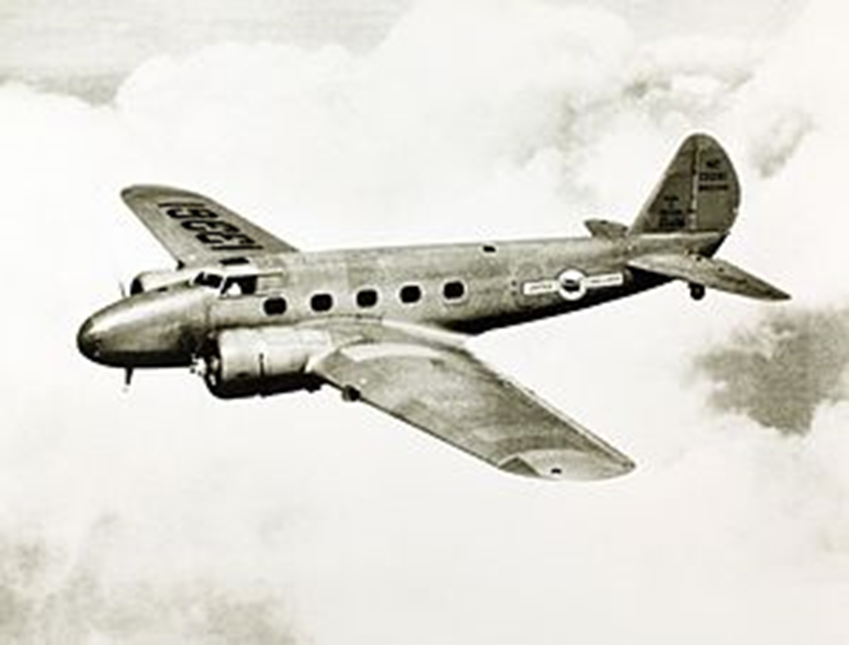
Issue
Forecasts are only as reliable as expert/non-expert predictions
Expert predictions without an underlying quantitative model are unreliable predictors of technological progress (Armstrong et al. 2014, Autor 2014/2015, Grace et al. 2019)
Forecast are unlikely to be reliable

Slide 7
Our Model

Slide 8
Our Contribution
Build first simple empirical forecasting model of computerisibility of tasks – computationally simulate firms and how they interact
Estimate of computerisability of tasks in 2018
Build dataset of all firms working on computerising different types of task
Validate model with prediction of current computerizability from past data
Can map to occupations to forecast full and partial computerisability

Slide 9
Output
‘Level of Automation’ of each of the 19 task types in 2050
This is a measure of the complexity that can be automated using computer controlled equipment at this time - based on O*NET ‘level’ scale
1 is the highest level of complexity of a task which can be performed by a human at this time

Slide 10
Dataset
Compiled dataset of all of the firms working to automate each of type of task
Used Venture Scanner AI Start-up dataset, Robot Report Robotics Start-up dataset, NASDAQ stock market listings, QS Universities Rankings
Used set of occupations/parts of occupations that have shown the potential to be automated and their O*NET ‘abilities’ ratings to work out current levels of automation

Slide 11
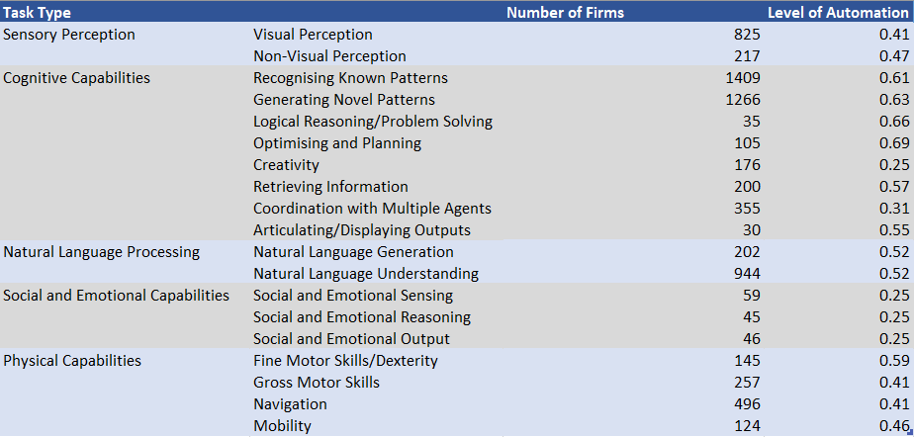
Dataset
Figure 1. Number of Firms and Level of Automation for Each Task Type (2018)

Slide 12
What The Firms Do
Receive funding – simulating research grants etc
Collaborate
Carry out research projects – attempt as many as can afford - can be
‘radical’ or ‘incremental’
4) Check if they want to adopt others’ technology/launch joint ventures
(Firms enter/exit the market)
5) Repeat – one time period represents one year

Slide 13
Results

Slide 14
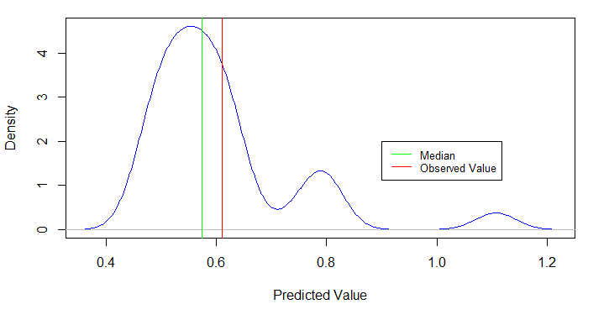
Vaildation
Performed Monte-Carlo simulation with n = 30 using 2000 data for firms working on “recognising known patterns/categories” i.e supervised learning
Figure 2. Distribution of Predictions for the Development of Supervised Learning in 2018
Able to reasonably successfully forecast level of automation for 2018 from this – median = 0.574 compared to 0.61

Slide 15
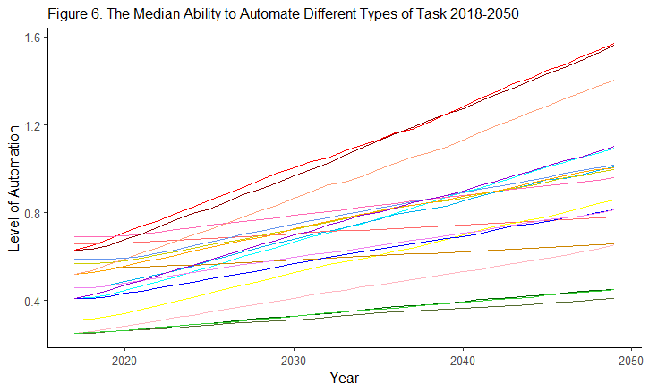
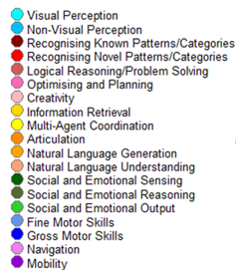
Results – Monte-Carlo Run
Figure 3. The Median Ability to Automate Different Types of Task 2018-2050, n=100

Slide 16
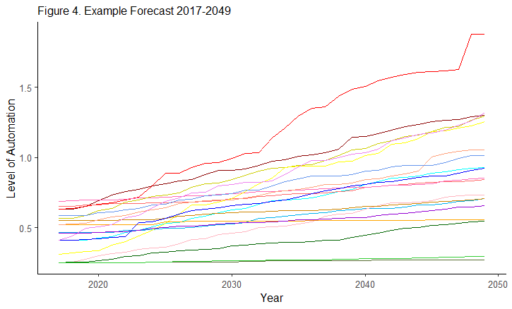
Results
Figure 4. Example Individual Run 2018-2050 (US Firms Only)

Slide 17
Analysis
Reproduces multiple stylised facts:
Produces ‘linked S-curves’ (Heebyung and Magee 2006)
Reproduces firm clustering (Cantner and Meder 2007)
Exhibits positive/negative feedback loops, and can reproduce empirical patterns like industry decline

Slide 18
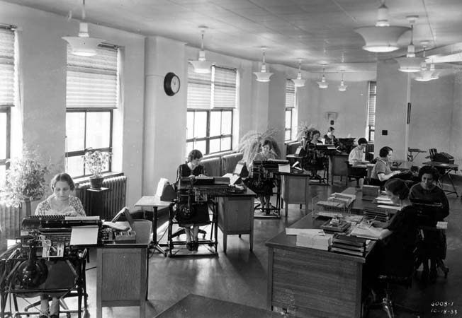
Partial Automation Potential
Key impact of automation is automation of individual tasks within occupations
Potentially large impact, and cause of job displacement
Probability tasks will be automated not necessarily linked to probability whole occupation will be automated

Slide 19
Partial Automation Potential
Proportion of occupation i automatable at t:
$$A_{i,t}=\frac{\sum_{j}{I_{ij}A_{ijt}}}{\sum_{j}{I_{ij}}}.$$
Where:
$A_{ijt}$ = 1 iff ability j in occupation i is computerisable at t, and
$I_{ij}$ is the importance of ability j for occupation i.

Slide 20
Questions? (Kieran.Marray@maths.ox.ac.uk)

Slide 21
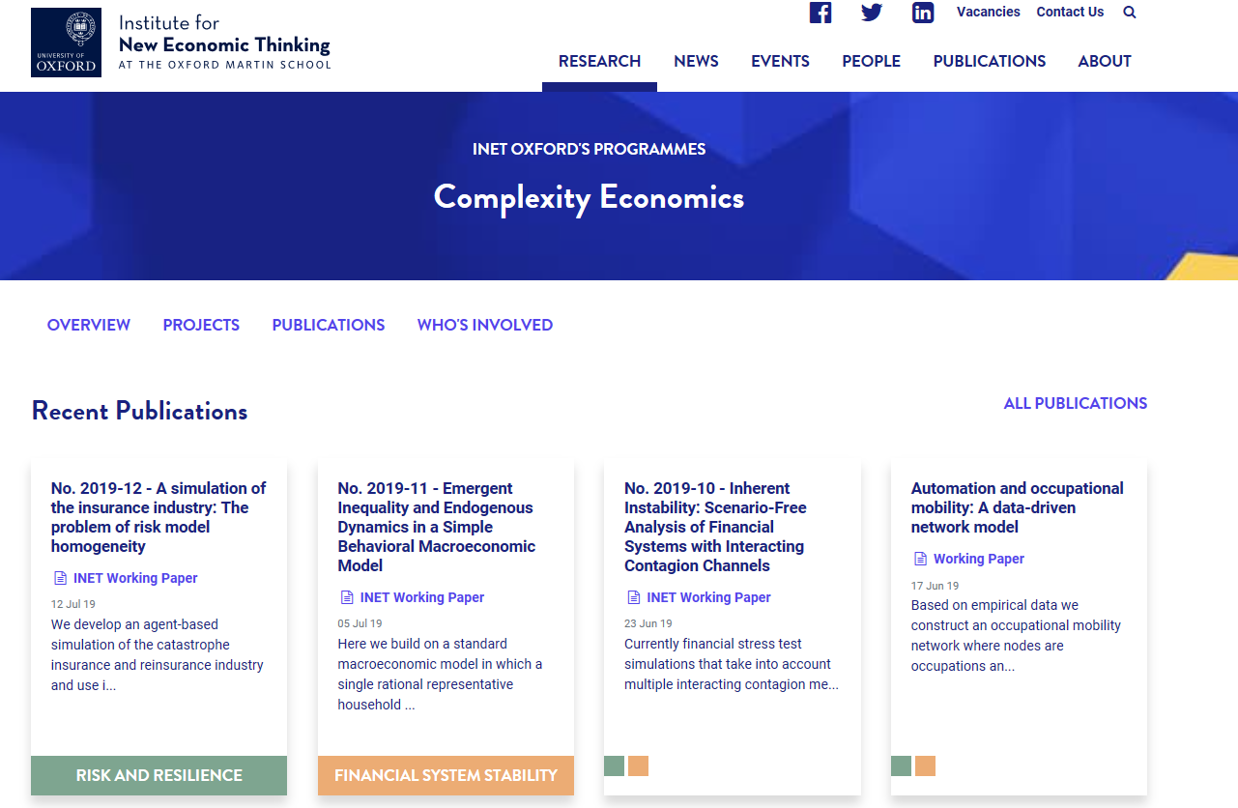

Slide 22
Selected References
Manyika et al. (2017). A Future That Works: Automation, Employment, and Creativity
Newman, Mark (2001). The Structure of Scientific Collaboration Networks, Proceedings of the National Academy of Sciences Vol. 98:2, 404-409
Shi et al. (2015). Weaving the Fabric of Science: Dynamic Network Models of Science’s Unfolding Structure, Social Networks Vol. 43, 73-85

Slide 23
Appendix

Slide 24
Results

Slide 25
Figure 10. The Median Ability to Automate Different Types of Task in 2050, n=100
Task Type | Level of Automation
Visual Perception | 1.090
Non-Visual Perception | 0.969
Retrieving Information | 0.975
Recognising Known Patterns/Categories | 1.534
Generating Novel Patterns/Categories | 1.558
Logical Reasoning/Problem Solving | 0.780
Optimising and Planning | 0.954
Creativity | 0.618
Articulating/Displaying Output | 0.649
Coordinating with Multiple Agents | 0.859
Natural Language Generation | 0.996
Natural Language Understanding | 1.300
Social and Emotional Sensing | 0.449
Social and Emotional Reasoning | 0.412
Social and Emotional Output | 0.438
Fine Motor Skills/Dexterity | 1.009
Gross Motor Skills | 0.809
Navigation | 1.076
Mobility | 0.804

Slide 26
Detail on Time-Steps

Slide 27
ρτm,t = argmax{ρi,t|∀i ∈ τm}
fi,t = α+βιi,t−1
ν =bfi,t cν c

Slide 28
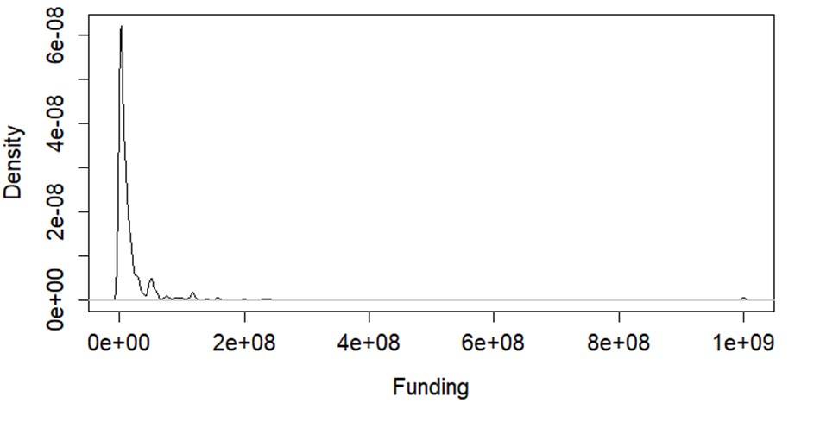
Funding
Figure 3. The Distribution of Research and Development Funding Across AI Firms
Funding evolves over time:
$${Funding}_{t}=f\left({Innovations}_{t−1}\right)$$
Notes:
𝐼𝑛𝑖𝑡𝑖𝑎𝑙 𝐹𝑢𝑛𝑑𝑖𝑛𝑔 ~ 𝐼𝐺(20662185, 1384173)

Slide 29
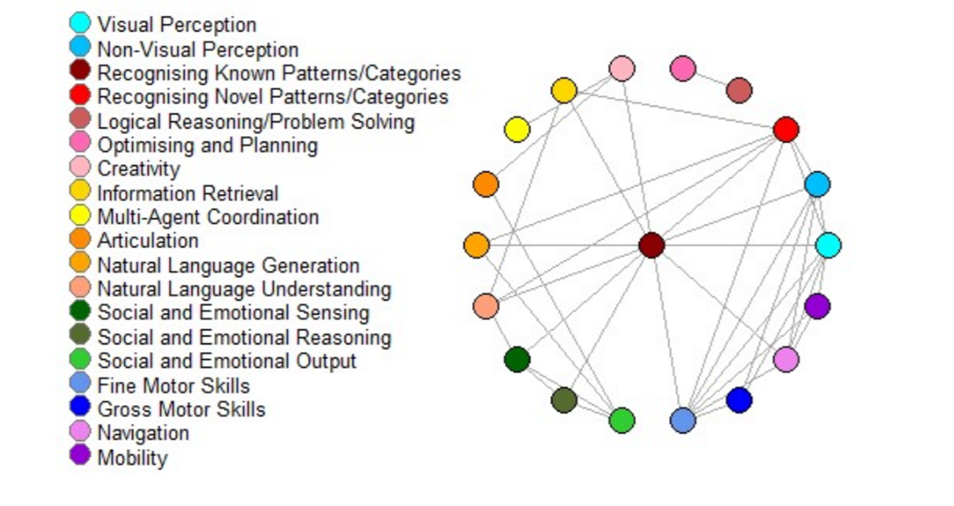
Collaboration
Figure 4. Collaboration Between Firms Automating Different Types of Task in 2018, Task-Type Level
Edges represent collaboration between firms – average degree is 3.59
Each time period, firms break off some of their connections and form new ones - $p\left(break\right)=\frac{1}{3}$
Newman (2001) and Shi et al. (2015)

Slide 30
Collaboration
Figure 5. The Decision Tree Firms Go Through to Collaborate Each Time-Step

Slide 31
Research
Firms then spend their funding on research projects
Can carry out two types of project – radical and incremental:
$${p(radical)}_{i }=0.25$$
$${p(incremental)}_{i}=0.75$$
(Kane 2016)
Incremental projects are more likely to be successful than incremental ones
Radical projects have greater potential payoffs than incremental ones

Slide 32
Information Diffusion
Firms consider neighbours on the network
If they are working on automating the same task type, then they can decide to adopt their technology based on a resistance function (Peyton-Young 2004)
If they are working on automating different types of task, they can launch a ‘joint venture’ – increases the probability of a successful incremental innovation by $0.2$ (Santamaria et al. 2015)

Slide 33
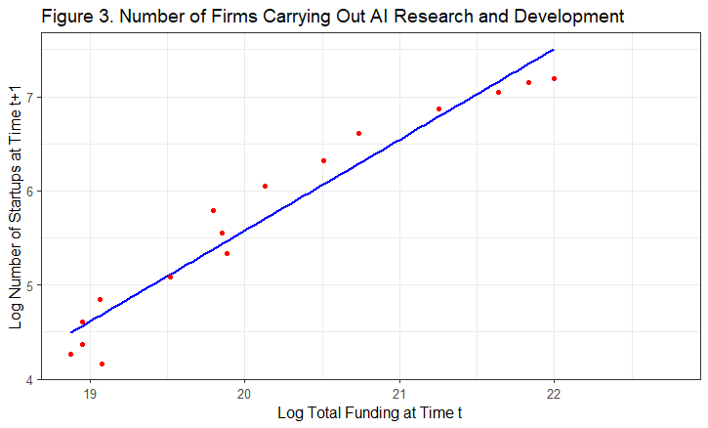
Market Entry/Exit
Significant at 0.1% level – adjusted $R^{2}$ of 0.936
Interesting points –models with other lags not significant – very short time-series though, which means that cointegration/ADF tests have very low power
Figure 6. The Relationship Between the Total Funding and the Number of Firms

